Slide 1
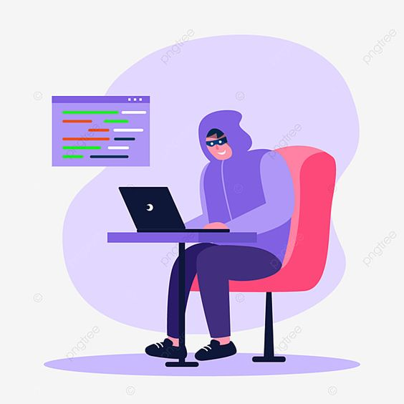
Phishing
Attacks.

Slide 2
Don't Get Hooked! Phishing Awareness Training
Welcome to this phishing awareness training module. In today's digital world, phishing attacks are a major threat to individuals and organizations. This training will equip you with the knowledge and skills to identify and avoid these scams, protecting your personal information and financial security.

Slide 3
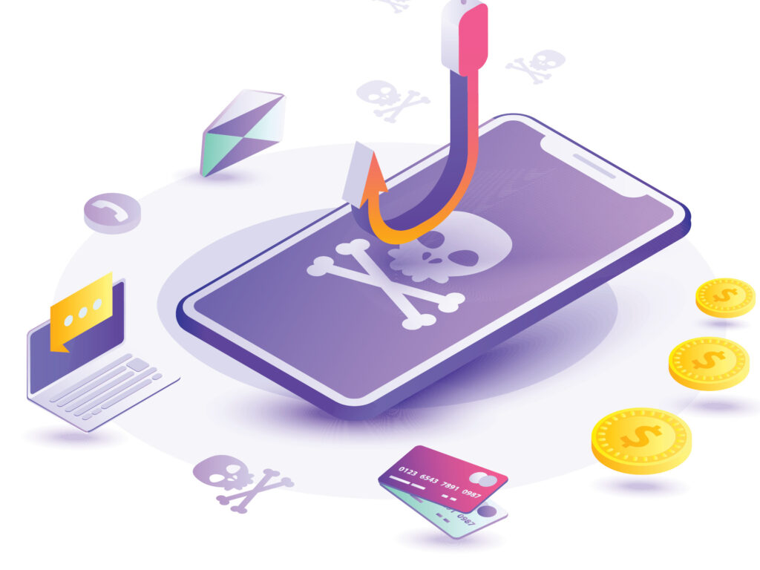
What is Phishing?
Phishing is a cybercrime that tries to trick you into revealing personal information, such as passwords, credit card numbers, or Social Security numbers. It is a deceptive attempt to steal your valuable information. Phishers use emails, websites, phone calls, and text messages to appear trustworthy
Phishers often impersonate legitimate companies or individuals to gain your trust.

Slide 4
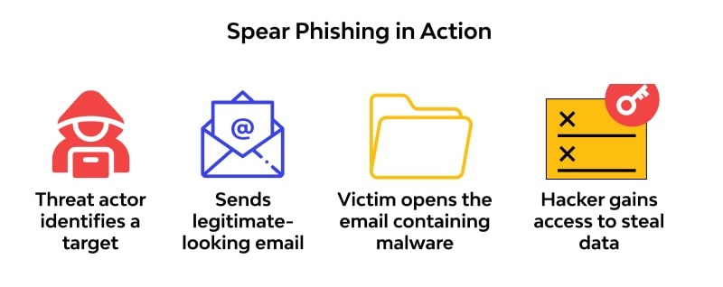
How Phishing Works
Identify Targets: They may target individuals or organizations based on their interests or vulnerabilities.
Steal Information: The link or attachment leads to a fake website or malware that steals your information.
Craft Phishing Messages: They create emails, websites, or social media messages that appear legitimate.
Deceive Victims: They use urgency, fear, or curiosity to trick you into clicking a link or downloading an attachment.

Slide 5
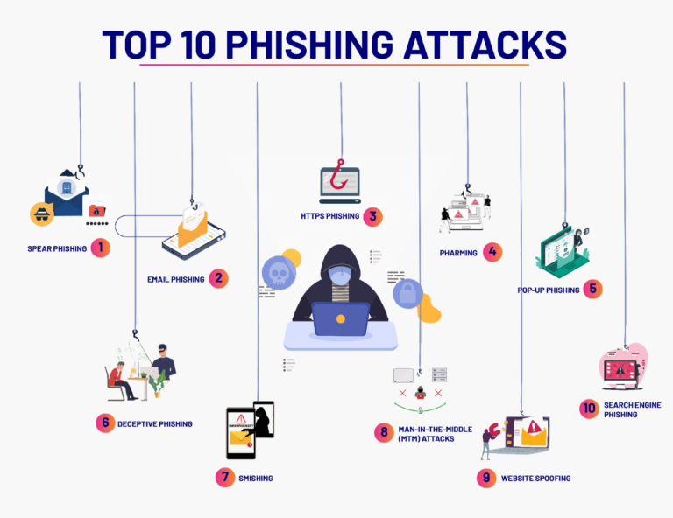

Slide 6
Types of Phishing Attacks
Email Phishing: The most common type, using emails that appear to be from legitimate sources.
Vishing: Phishing attempts via phone calls.
Smishing: Phishing attempts via SMS text messages.
Spear Phishing: Targeted phishing attacks aimed at specific individuals or organizations.

Slide 7
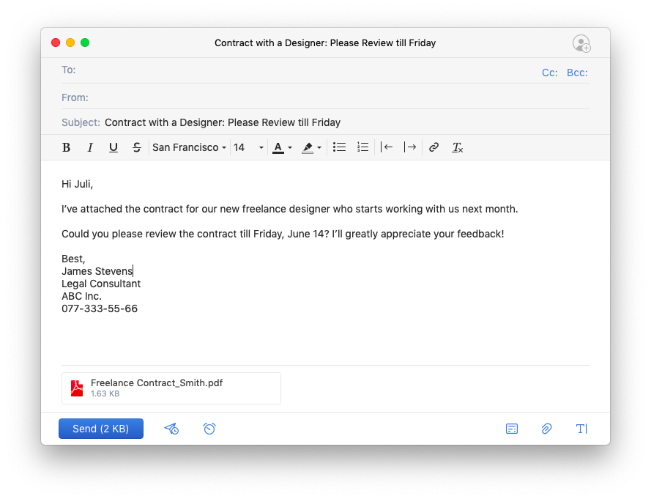
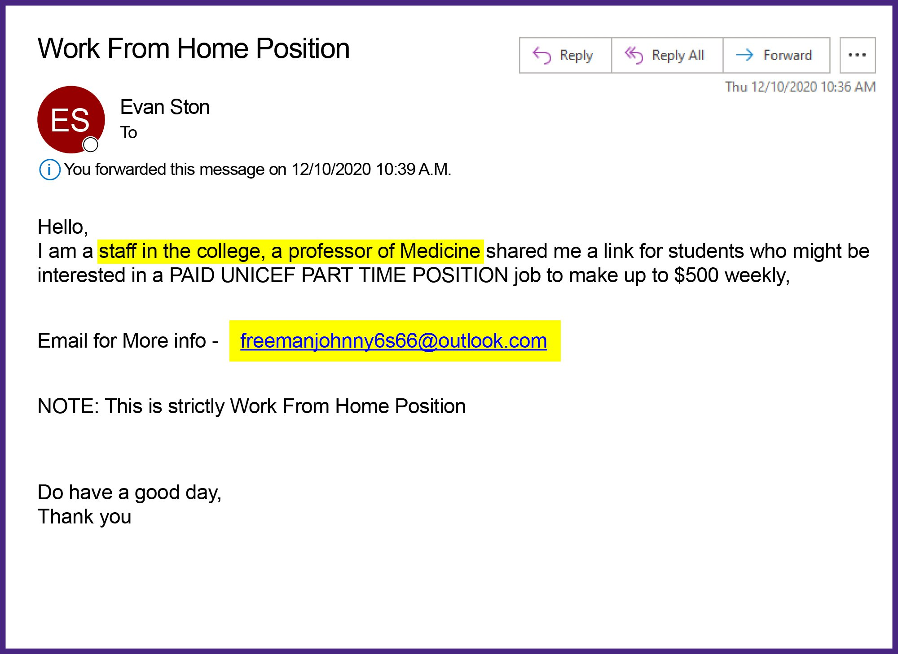
Recognizing Phishing Emails
A phishing email with a suspicious sender address, unprofessional formatting, and typos.
Legitimate email with clear sender information, professional formatting, and no grammatical errors.
Watch out for these red flags in emails:
Suspicious Sender Address: Check the sender's email address carefully. Does it look legitimate?
Urgent Tone: Phishers often create a sense of urgency to pressure you into acting quickly.
Generic Greetings: Legitimate companies typically address you by name.
Grammatical Errors and Typos: Professional emails should be free of errors.
Threats or Incentives: Phishers may threaten to close your account or offer unrealistic rewards.
Suspicious Links or Attachments: Don't click on links or open attachments from unknown senders

